Slide 1

Computer Vision Use Case in Line Detection for Smart Vehicles
ADITYA DHAKA
JORGE MATEUS

Slide 2
Outline of the presentation
PROBLEM STATEMENT
METHOD
EXPERIMENTAL SETUP
RESULTS

Slide 3
Problem statement
A deep understanding of lane boundary position is vital for vehicle safety, which is needed to avoid collisions and localize vehicle.
Lanes boundaries detection accuracy has increased significantly since introduction of deep learning, with majority of recent systems using convolutional neural networks to process sensorial data and infer high-level information.
The use of LiDAR is extremely expensive therefore as an alternative, comparatively cheaper cameras are used which can utilize chromatic differences on the road.

Slide 4
Related work
[1] used a modified version of Faster R-CNN for identifying road patches that belong to lane markings. Then those patches are jointed to obtain complete representation of the marking. But due to high frame rate of 4 frames per seconds during high-speed driving, it’s not suitable for real-time elaboration.
To achieve lane markings detection and classification [2, 3, 4] used fully-convolutional networks which enables more complex path planning tasks
[6, 7, 8, 9] used a fully-convolutional networks to obtain a pixelwise representation of lane boundaries.

Slide 5
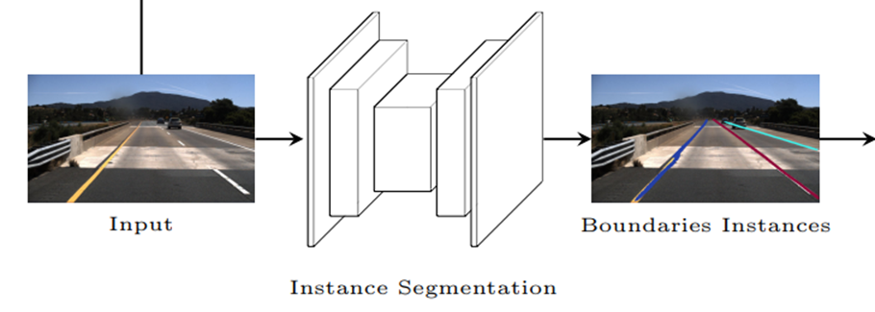
Aim
Lane Detection
We trained the CNN to recognize lane boundaries, rather than lane markings to avoid grouping different lane markings in a lane boundary to save processing time.
Instead of semantic segmentation, we performed instance segmentation on lane boundaries, to distinguish different lane boundaries without relying on clustering algorithms.
We used ERFNet architecture as baseline model since Mask R-CNN is not suggested for use in real-time application

Slide 6
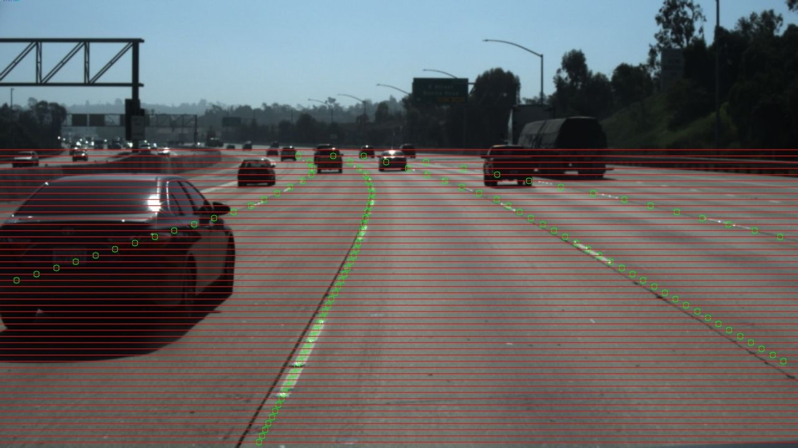
Dataset
TuSimple dataset is used for lane detection. It is consists of 6408 1280×720 road images on US highways, divided in 3626 for training, and 2782 for testing. 410 images extracted from the training set have been used as validation set during training.
[10]

Slide 7
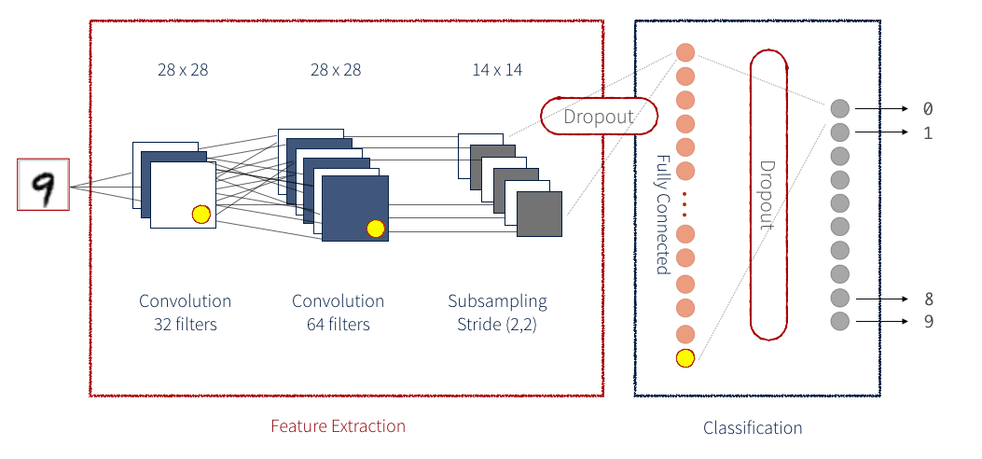
Crack Detection
To detect crack, we used classification approach, in which, images and label are fed to deep learning architecture (50 layers deep resnet50). The model learns from it and when unknown images are provided, it predicts the label.

Slide 8
Results (Lane Detection)
Input video
Output video

Slide 9
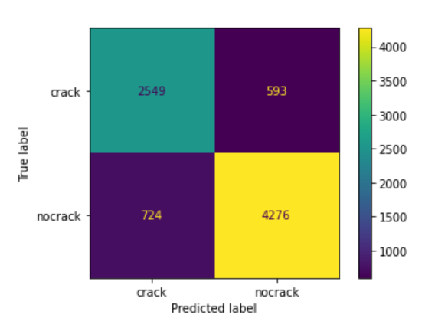
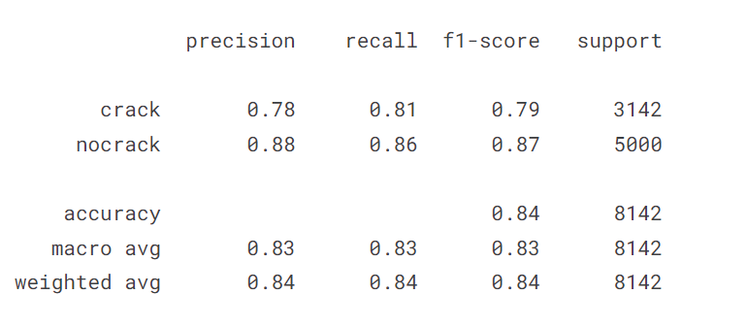
Results (Crack Detection)
The table below tracks the accuracy at which cracks are identified. It tracks False Positives (FP), True Positives (TP) and False Negatives (FN), as well a True Negatives (TN)
Epoch 5

Slide 10
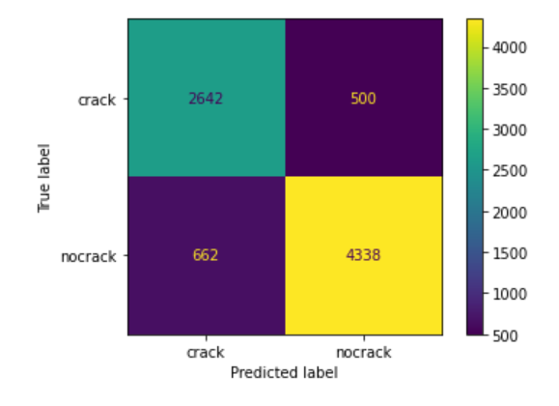
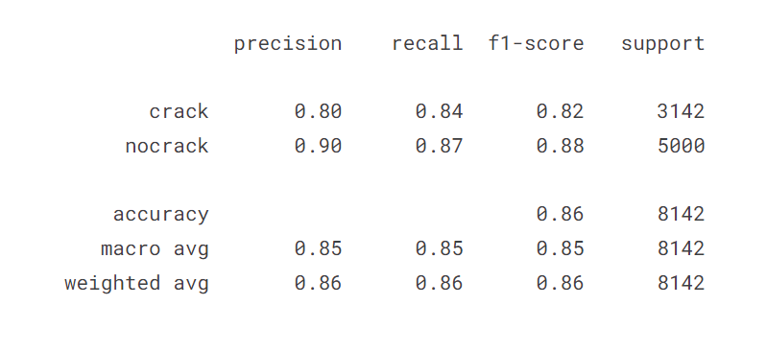
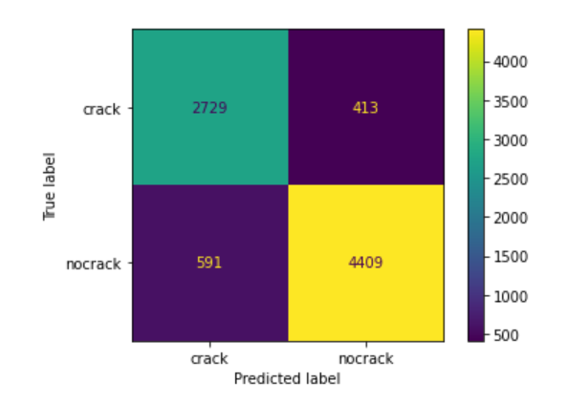
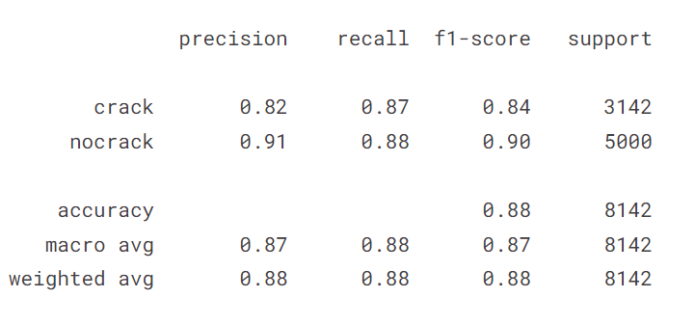
Epoch 10
Epoch 15

Slide 11
Conclusion
We have successfully implemented Lane detection and further added crack detection feature in it (with the accuracy of 88% and F1 score 0.90).
The number of FN and FP is high because we used 10 epochs (a hyperparameter that defines the number of times that the algorithm will work through the entire training dataset). This impacts the precision of the algorithm as TP/(TP+FP). The graphs bellow shows the increase of the precision as the epoch increase. It also depends on the size of the architecture i.e., a much more advanced CNN.

Slide 12
Future
To further improve the crack algorithm effectiveness a few suggestions are:
Increase the epoch which will increase the time to train the model as well as demand more computational power.
The use more layers in the network and/or use large dataset.
Image augmentation. Pre-process the image before training the model.
While this may improve the precision of the algorithm, the relationship with the output or precision is not linear, as there can be a threshold when the result stop getting better.

Slide 13
References
[1] Tian, Y., Gelernter, J., Wang, X., Chen, W., Gao, J., Zhang, Y., Li, X.: Lane marking detection via deep convolutional neural network. Neurocomputing (2018)
[2] Bai, M., Mattyus, G., Homayounfar, N., Wang, S., Lakshmikanth, S.K., Urtasun, R.: Deep multi-sensor lane detection. In: 2018 IEEE/RSJ International Conference on Intelligent Robots and Systems (IROS). (2018)
[3] Chen, P., Lo, S., Hang, H., Chan, S., Lin, J.: Efficient road lane marking detection with deep learning. CoRR abs/1809.03994 (2018)
[4] Tian, Y., Gelernter, J., Wang, X., Chen, W., Gao, J., Zhang, Y., Li, X.: Lane marking detection via deep convolutional neural network. Neurocomputing (2018)
[5] Ren, S., He, K., Girshick, R., Sun, J.: Faster r-cnn: Towards real-time object detection with region proposal networks. In: Advances in NIPS. (2015)

Slide 14
[6] Neven, D., De Brabandere, B., Georgoulis, S., Proesmans, M., Van Gool, L.: Towards end-to-end lane detection: an instance segmentation approach. In: 2018 IEEE Intelligent Vehicles Symposium (IV), IEEE (2018) 286–291
[7] Pan, X., Shi, J., Luo, P., Wang, X., Tang, X.: Spatial as deep: Spatial cnn for traffic scene understanding. In: 32nd AAAI Conference on Artificial Intelligence. (2018)
[8] Zhang, J., Xu, Y., Ni, B., Duan, Z.: Geometric constrained joint lane segmentation and lane boundary detection. In: ECCV. (2018) 486–502
[9] Kim, J., Park, C.: End-to-end ego lane estimation based on sequential transfer learning for self-driving cars. In: Proceedings of the IEEE CVPR Workshops. (2017)
[10] https://www.linkedin.com/pulse/tusimple-announces-worlds-first-autonomous-benchmark-dataset-stevens

